Slide 1




Chatbot Using Deep Learning

Slide 2

WHY CHATBOTS ?
Chatbots Now and In Our Future

Slide 3



PROBLEM STATEMENT
If you look at how humans talk to each other. The context matters. The bot should consider the context – “What the user said before, when and where and how they said should influence how the conversation goes.
The bot should gracefully handle unexpected dialogue turns and drive the conversations when the user drifts from the regular conversation path.
The bot should be capable of understanding and responding to different and unexpected inputs.

Slide 4

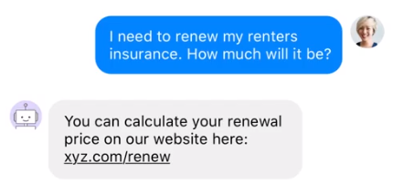
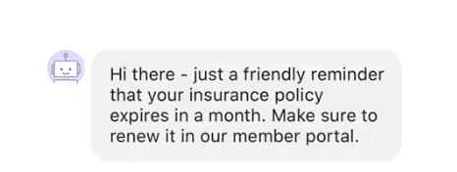
Existing Methods
Notification Assistants:
Chatbots – FAQ’s
The most common type of assistants at the moment
They allows the users to ask simple questions and get the answers. They are a slight improvement to the notification assistants.
Often constructed around a set of rules or a state machine.
You would have interacted with these assistants in your laptops or mobile phones.
They are capable of sending simple notifications, like a text message, push notification, or WhatsApp message

Slide 5





What Contextual AI Assistants Are?
Contextual AI Assistants are a big step further from FAQ’s and Notifications
Capable of understanding and responding to different and unexpected inputs
Can learn from previous conversations and improve in accuracy over time.

Slide 6


Proposed System
Contextual AI Assistants consider the context of what has been said before which is a very important part of every natural conversation.
We have built a Contextual AI Assistant that interacts with the user and also provides weather information.
As they consider the context of what has been said before they can gracefully handle unexpected dialogue turns and drive the conversation when the user drifts from the regular conversation path and improve over time.
We build it with Rasa
Context

Slide 7
LITERATURE REVIEW
Name of the Paper | Year of Publication | Journal-Name-Volume | Feature / Techniques
A Survey on Chatbot Implementation in Customer Service Industry through Deep Neural Networks, 2018 IEEE 15th International Conference on e-Business Engineering (ICEBE) | 2019 | IRJET [Volume-6] | An android mobile application using Recurrent Neural Network
A Survey On Chatbot Conversational Systems - Ayesha Shaikh1, Geetanjali Phalke2, Pranita Patil3, Sangita Bhosale4, Jyoti Raghatwan5 – IJESC | 2016 | IJESC | Example Based Dialogue Management System
Correcting Linguistic Training Bias in an FAQ-bot using LSTM-VAE - Mayur Patidar, Puneet Agarwal, Lovekesh Vig, and Gautam Shro. | 2016 | IJESC [Volume -6] | LSTM Classifier
A Chatbot Using LSTM-based Multi-Layer Embedding for Elderly Care. Publisher: IEEE Authors: Ming-Hsiang Su ; Chung-Hsien Wu ; Kun Yi Huang ; Qian-Bei Hong ; Hsin-Min Wang. | 2015 | IEEE | LSTM Model to deal with semantic relation between words.
Automated Thai-FAQ Chatbot using RNN-LSTM Publisher: IEEE Authors: Panitan Muangkammuen ; Narong Intiruk ; Kanda Runapongsa Saikaew. | 2015 | IEEE | Recurrent Neural Network with Long Short Term Memory for Text Classofication.
RNN and LSTM based Chatbot using NLP - Poonam Dhankhar. | 2015 | IEEE | Recurrent Neural Network with Long Short Term Memory for Text Classofication

Slide 8
LITERATURE REVIEW
Name of the Paper | Year of Publication | Journal-Name-Volume | Feature / Techniques
Problem solving chatbot for data structures Authors: Ankil Shah ; Bhargav Jain ; Bhavin Agrawal ; SaurabhJain ; Simon Shim | 2015 | IEEE | Recurrent Neural Network
The chatbot feels you - a counseling service using emotional response generation. Authors: Dongkeon Lee ; Kyo-Joong Oh ; Ho-Jin Choi | 2013 | IEEE | POS - Tagging
An Information Retrieval-based Approach for Building Intuitive Chatbots for Large Knowledge Bases - Andreas Lommatzsch and Jonas Katins TU Berlin, DAI-Labor, Ernst-Reuter-Platz. | 2012 | International Journal of Advanced Research in Computer and Communication Engineering | Rule Based and State Machine
Artificial Intelligence Chatbot in Android System using Open Source Program-O Publisher: International Journal of Advanced Research in Computer and Communication Engineering Authors: Sarthak V. Doshi1 , Suprabha B. Pawar2 , Akshay G. Shelar3 , Shraddha S. Kulkarni4 | 2011 | IRJET | Recurrent Neural Network with Long Short Term Memory for Text Classification.
Scalable Sentiment for Sequence-To-Sequence Chatbot Response With Performance Analysis Authors: Chih-Wei Lee, Yau-Shian Wang, Tsung-Yuan Hsu, Kuan-Yu Chen, Hung-Yi Lee, Lin-Shan Lee. | 2009 | IJESC | Recurrent Neural Network
Chatbots Using Clustered Actions and Human-Likeness Rewards Authors: Heriberto Cuáyahuitl ; Donghyeon Lee ; Seonghan Ryu ; Sungja Choi | 2008 | IEEE | Example Based Dialogue Management Sysem

Slide 9
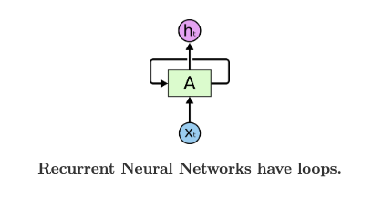
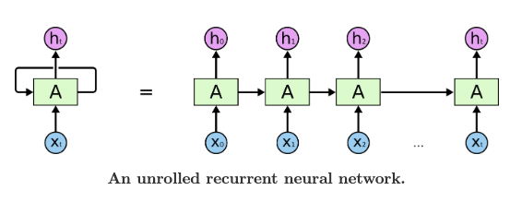
RNN Humans don’t begin thinking from scratch
Every word is understood based on the previous one
Simple networks can’t achieve this, this is where RNN was introduced (a chain of neural network with a loop)
Related to sequences and list
Speech recognition
Language modeling
Translation
Image captioning
RNN

Slide 10
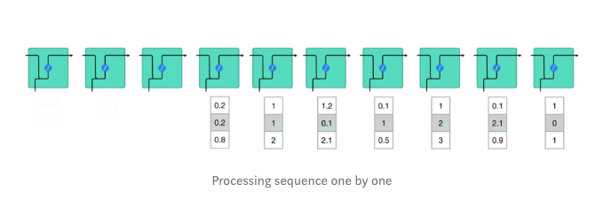
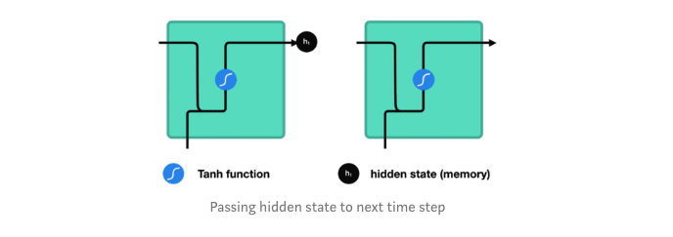
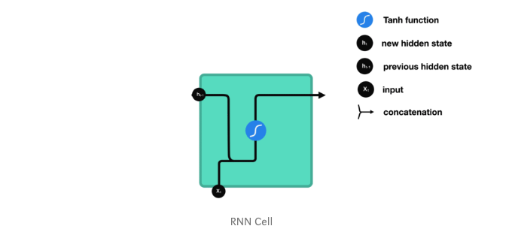
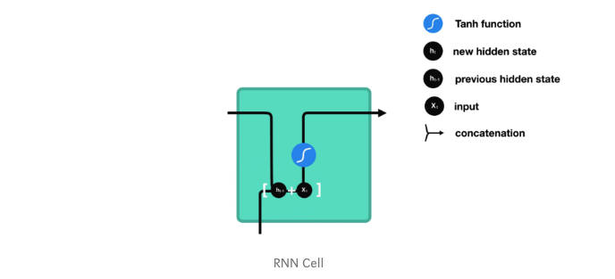
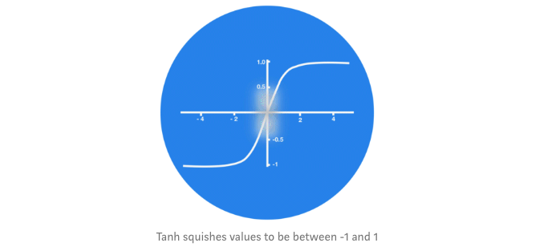

Slide 11
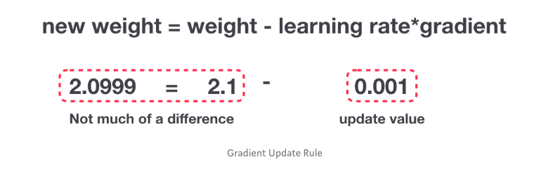
The Problem, Short-term Memory
Recurrent Neural Networks suffer from short-term memory. If a sequence is long enough, they’ll have a hard time carrying information from earlier time steps to later ones. So if you are trying to process a paragraph of text to do predictions, RNN’s may leave out important information from the beginning.
During back propagation, recurrent neural networks suffer from the vanishing gradient problem. Gradients are values used to update a neural networks weights. The vanishing gradient problem is when the gradient shrinks as it back propagates through time. If a gradient value becomes extremely small, it doesn’t contribute too much learning.
So in recurrent neural networks, layers that get a small gradient update stops learning. Those are usually the earlier layers. So because these layers don’t learn, RNN’s can forget what it seen in longer sequences, thus having a short-term memory.

Slide 12
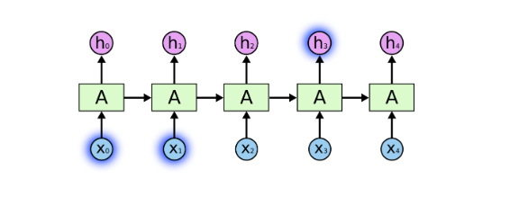
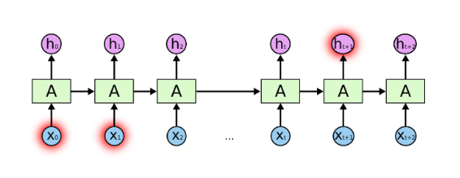
consider a language model trying to predict the next word based on the previous ones.
While trying to predict the last word in the sentence, “the clouds are in the _______” obviously we predict it to be sky why because it is from our previous understanding.
This is where the RNN model fail to achieve the goal.
RNN’s can learn to use the past information but there are also cases where the context plays a vital role.
Unfortunately, as that gap grows, RNNs become unable to learn to connect the information.
The Problem of Long-Term Dependencies

Slide 13
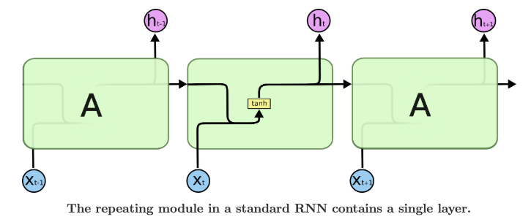
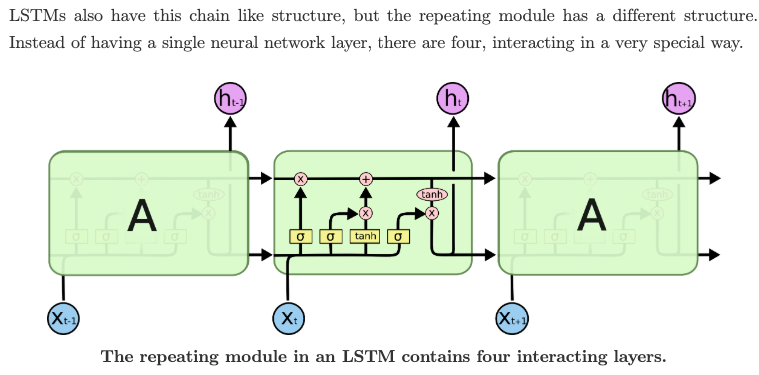

Slide 14
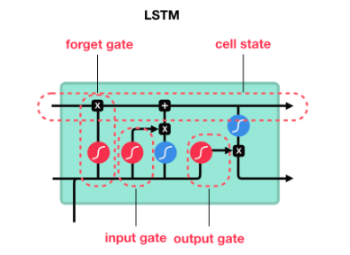
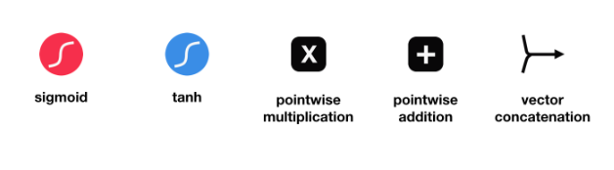
LSTM
Long Short Term Memory networks – usually just called “LSTMs” – are a special kind of RNN, capable of learning long-term dependencies.
LSTMs are explicitly designed to avoid the long-term dependency problem. Remembering information for long periods of time is practically their default behavior, not something they struggle to learn
LSTM ’s were created as the solution to short-term memory. They have internal mechanisms called gates that can regulate the flow of information.
!
LSTM

Slide 15
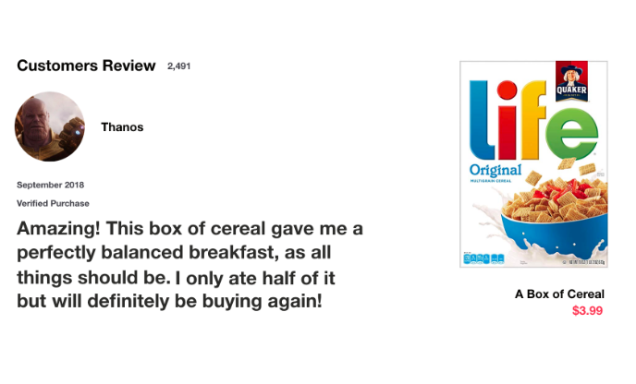
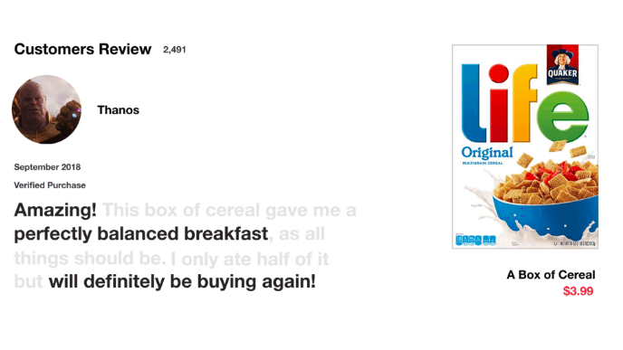
A simple explanation of LSTM with an example
The gates can learn which data in a sequence is important to keep or throw away. By doing that, it can pass relevant information down the long chain of sequences to make predictions.
And that is essentially what an LSTM does. It can learn to keep only relevant information to make predictions, and forget non relevant data. In this case, the words you remembered made you judge that it was good.

Slide 16
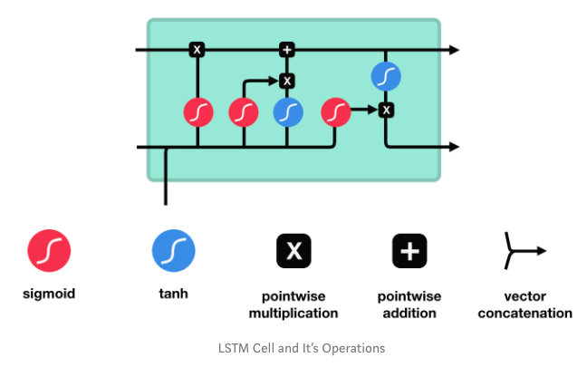
CORE CONCEPT
The core concept of LSTM are the cell state, and it’s various gates.
The cell state act as a transport highway that transfers relative information all the way down the sequence chain. You can think of it as the “memory” of the network.
The cell state, in theory, can carry relevant information throughout the processing of the sequence. So even information from the earlier time steps can make its way to later time steps, reducing the effects of short-term memory.
As the cell state goes on its journey, information gets added or removed to the cell state via gates.
The gates are different neural networks that decide which information is allowed on the cell state. The gates can learn what information is relevant to keep or forget during training.
!
LSTM

Slide 17
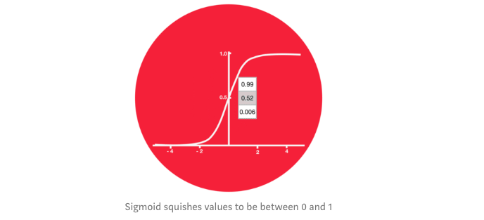
SIGMOID ACTIVATION FUNCTION
Gates contains sigmoid activations.
A sigmoid activation is similar to the tanh activation. Instead of squishing values between -1 and 1, it squishes values between 0 and 1.
That is helpful to update or forget data because any number getting multiplied by 0 is 0, causing values to disappears or be “forgotten.”
Any number multiplied by 1 is the same value therefore that value stays the same or is “kept.”
The network can learn which data is not important therefore can be forgotten or which data is important to keep.

Slide 18
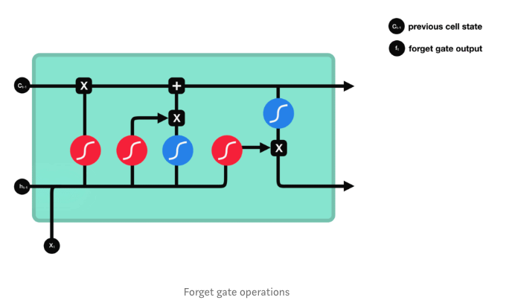
Forget GATE
First, we have the forget gate. This gate decides what information should be thrown away or kept.
Information from the previous hidden state and information from the current input is passed through the sigmoid function.
Values come out between 0 and 1. The closer to 0 means to forget, and the closer to 1 means to keep.

Slide 19
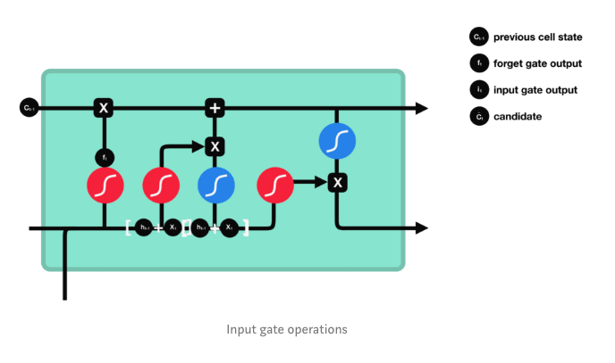
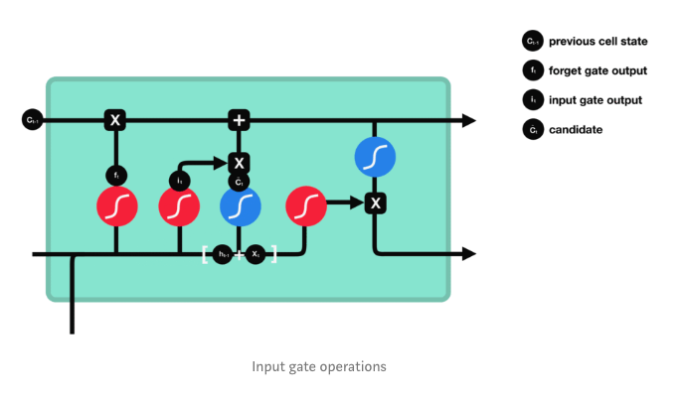
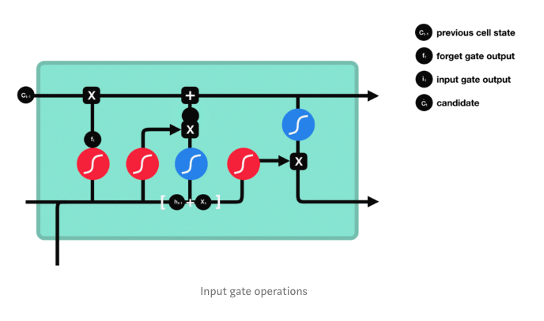
INPUT GATE
To update the cell state, we have the input gate.
First, we pass the previous hidden state and current input into a sigmoid function. That decides which values will be updated by transforming the values to be between 0 and 1.
0 means not important, and 1 means important.
You also pass the hidden state and current input into the tanh function to squish values between -1 and 1 to help regulate the network.
Then you multiply the tanh output with the sigmoid output.
The sigmoid output will decide which information is important to keep from the tanh output.

Slide 20
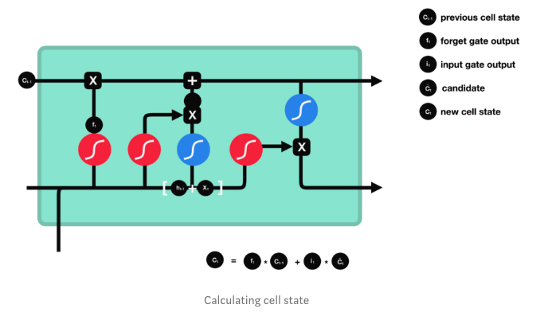
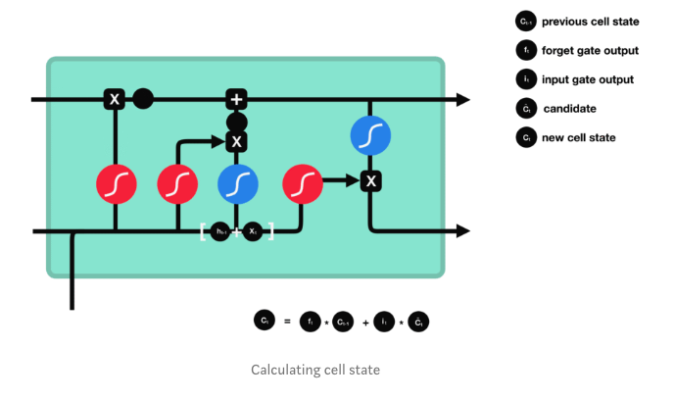
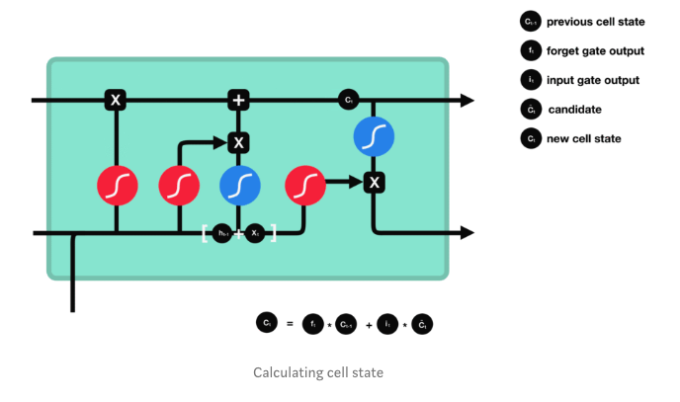
CELL STATE
Now we should have enough information to calculate the cell state.
First, the cell state gets pointwise multiplied by the forget vector. This has a possibility of dropping values in the cell state if it gets multiplied by values near 0.
Then we take the output from the input gate and do a pointwise addition which updates the cell state to new values that the neural network finds relevant. That gives us our new cell state.

Slide 21
OUTPUT GATE
The output gate decides what the next hidden state should be. Remember that the hidden state contains information on previous inputs.
The hidden state is also used for predictions. First, we pass the previous hidden state and the current input into a sigmoid function.
Then we pass the newly modified cell state to the tanh function.
We multiply the tanh output with the sigmoid output to decide what information the hidden state should carry.
The output is the hidden state. The new cell state and the new hidden is then carried over to the next time step.

Slide 22
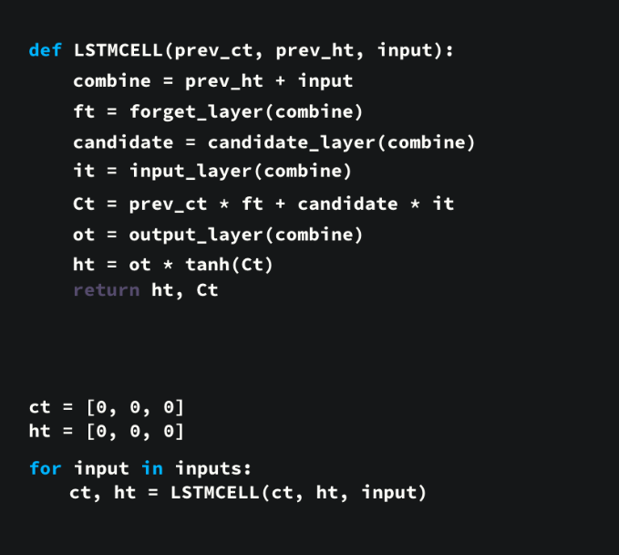
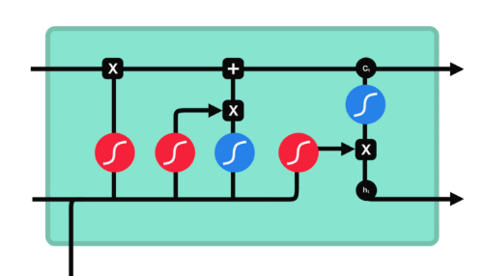
PSEUDO CODE
1. First, the previous hidden state and the current input get concatenated. We’ll call it combine.
2. Combine gets fed into the forget layer. This layer removes non-relevant data.
4. A candidate layer is created using combine. The candidate holds possible values to add to the cell state.
3. Combine also gets fed into the input layer. This layer decides what data from the candidate should be added to the new cell state.
5. After computing the forget layer, candidate layer, and the input layer, the cell state is calculated using those vectors and the previous cell state.
6. The output is then computed.
7. Pointwise multiplying the output and the new cell state gives us the new hidden state.

Slide 23
PROPOSED WORK

Slide 24
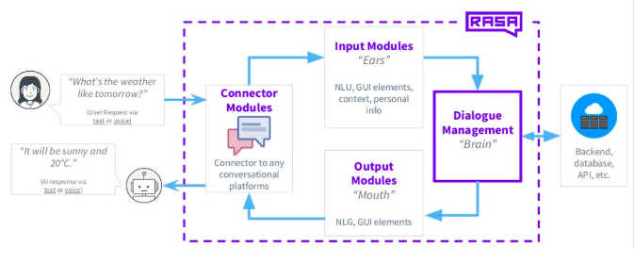
The Rasa core and Rasa NLU are open source python libraries for creating conversational software.
Their purpose is to make machine-learning based dialogue management and language understanding accessible to non-specialist software developers. The main component of the model is a recurrent neural network (an LSTM), which maps from raw dialog history directly to a distribution over system actions.
The LSTM automatically infers a representation of dialog history, which relieves the system developer of much of the manual feature engineering of dialog state. In addition, the developer can provide software that expresses business rules and provides access to programmatic APIs, enabling the LSTM to take actions in the real world on behalf of the user.
The LSTM can be optimized using supervised learning (SL), where a domain expert provides example dialogs which the LSTM should imitate; or using reinforcement learning (RL), where the system improves by interacting directly with end users.

Slide 25

Rasa is a set of open source machine learning framework for building chat and voice contextual assistants. It consists of two components:
Rasa NLU is like the “ear” of your assistant—it helps your assistant understand what’s being said.
Rasa NLU takes user input in the form of unstructured human language and extracts structured data in the form of intents and entities.
Intents are labels that represent the goal, or meaning, of a user’s specific input.
For example, the message ‘Hello’ could have the label ‘greet’ because the meaning of this message is a greeting.
Entities are important keywords that an assistant should take note of.
For example, the message ‘My name is Sweety’ has the name ‘Sweety’ in it. An assistant should extract the name and remember it throughout the conversation to keep the interaction natural.
Rasa Core
Core is Rasa’s dialogue management component. It is the brain.
It decides how an assistant should respond based on :
1) the state of the conversation and
2) the context.
3) It takes the structured input from the NLU and predicts the next best action using a probabilistic model like LSTM neural network.
Rasa Core learns by observing patterns in conversational data between users and an assistant.

Slide 26
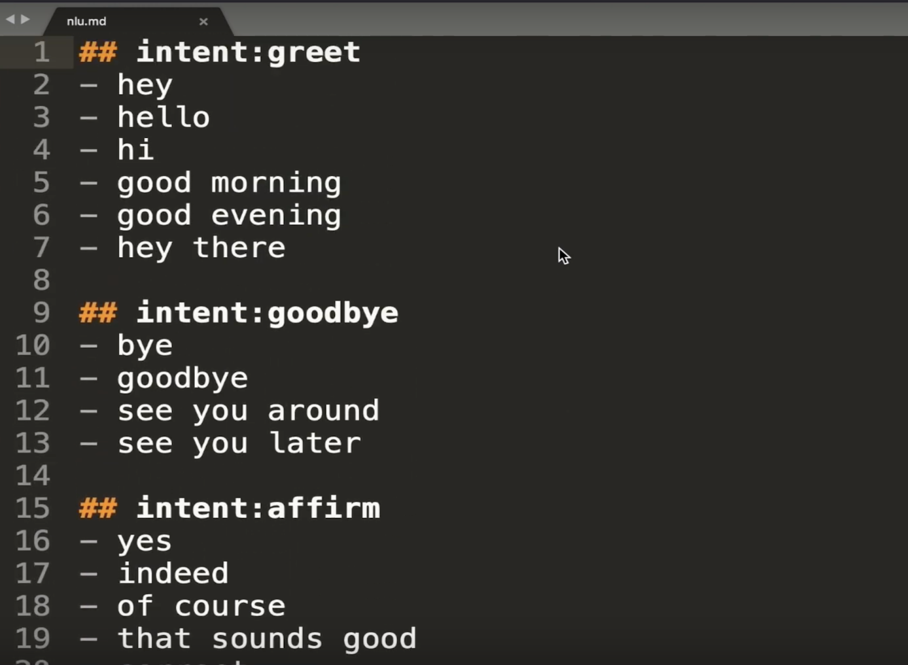
IMPLEMENTATION
When creating a conversational AI Assistant with RASA everything starts with training data.
Language Understanding
We create some training data here, grouping user messages by their intents. The intent describes what the messages mean.
Entities are labeled with square brackets and tagged with their type in parentheses. Syntax: [entity value](entity type):
The Data directory contains two files:
nlu.md - the file containing NLU model training examples. This includes intents, which are user goals, and example utterances that represent those intents. The NLU training data also labels the entities, or important keywords, the assistant should extract from the example utterance.
stories.md - the file containing story data. Stories are example end-to-end conversations.

Slide 27
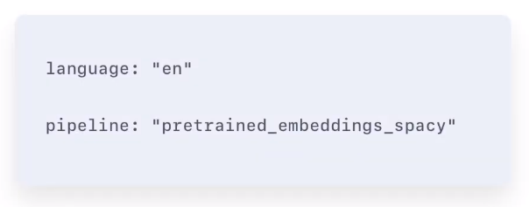
To properly train our NLU model:
To enable our assistant to understand the intents and extract the entities from the NLU data file we need to build a model. This is done by defining a processing pipeline.
A pipeline could be understood as a sequence of processing steps which allows the model to learn the training data’s underlying patters. There are two pipelines available. Both pipelines are capable of performing intent classification and entity extraction.
Pretrained_embeddings_spacy - Uses the spaCy library to load pre-trained language models, which are used to represent each word in the user’s input as word embeddings.
Advantages
Boosts the accuracy of your models, even if you have very little training data.
Supervised embeddings - Unlike pre-trained embeddings, the supervised embeddings pipeline trains the model from scratch using the data provided in the NLU training data file.
Advantages
Can adapt to domain-specific words and messages, because the model is trained on your training data.
Language-agnostic. Allows you to build assistants in any language.
Supports messages with multiple intents.
Word embeddings - Word embeddings convert words to vectors, or dense numeric representations based on multiple dimensions. Similar words are represented by similar vectors, which allows the technique to capture their meaning. Word embeddings are used by the training pipeline components to make text data understandable to the machine learning model.

Slide 28
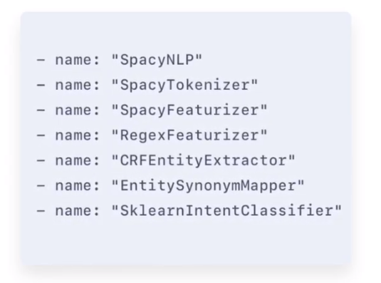
PIPELINES
It is responsible for loading the Language Model.
It is responsible for taking the user input in a unstructured human language and splitting them into tokens. A token can be a word.
It is used for making the predictions.
It is used for enitiy extraction
It is used for intent classification.

Slide 29
We train the model to recognize the intents, so that when the user sends a message like "hello" to the bot, it will recognize this as a "greet" intent.
Use & evaluate the NLU model
{'intent_evaluation':
{'predictions': [{'text': 'hey',
'intent': 'greet',
'predicted': 'greet',
'confidence': 0.9615294933319092},
{'text': 'hello',
'intent': 'greet',
'predicted': 'greet',
'confidence': 0.9637511968612671},
{'text': 'hi', 'intent': 'greet',
'predicted': 'greet',
'confidence': 0.9530026316642761},
{'text': 'good morning', ‘
intent': 'greet',
'predicted': 'greet',
'confidence': 0.9454197883605957},
{'text': 'good evening',
'intent': 'greet',
'predicted': 'greet',
'confidence': 0.9336825609207153}
}

Slide 30
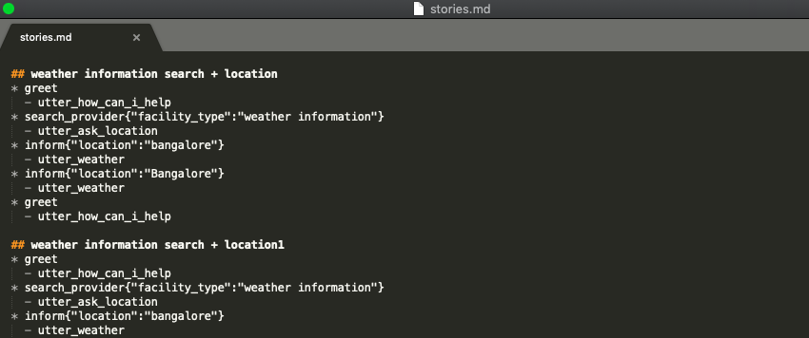
Adding dialogue capabilities Writing Stories A good place to start is by writing a few stories. These are example conversations that Rasa Core will learn from. The format works like this: A story starts with ## and you can give it a name. lines that start with * are messages sent by the user. Although you don't write the actual message, but rather the intent (and the entities) that represent what the user means.

Slide 31
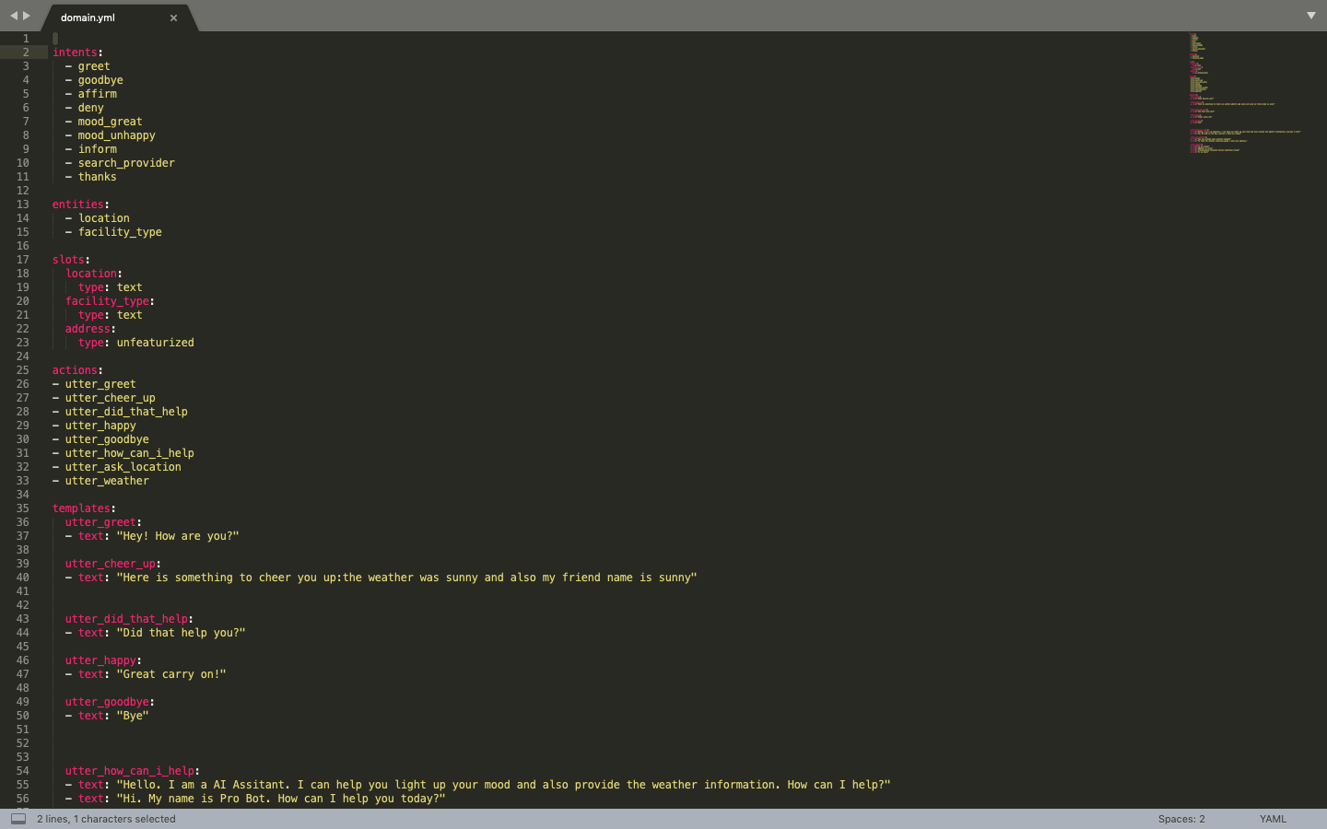
Defining a Domain The domain specifies the universe that your bot lives in. Here we list all of the intents and actions that show up in the stories. This is also the place to write templates, which contain the messages your bot can send back.

Slide 32
Adding Custom API methods We not only want to send back messages to the user, but also call the OpenWeatherMap API to get the current weather information of any location. Thus we have created custom actions that will be called once the bots ML model predicts them. Training your Dialogue Model Now comes the fun part! We're going to show Rasa Core the stories we wrote above, and train a model on these examples. In this case, the model is a neural network implemented in Keras i.e.(LSTM) which learns to predict which action to take next. Starting up the bot Now that we've trained the dialogue and language understanding models and saved them, we can start up an Agent which will handle conversations for us. Talking to the Bot We can start talking to the bot in natural language.

Slide 33
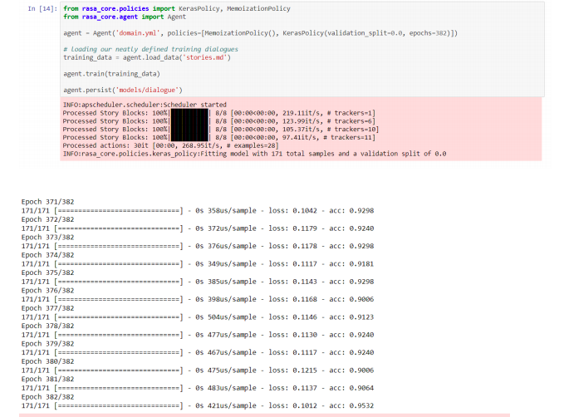
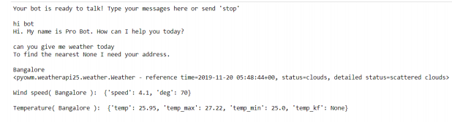
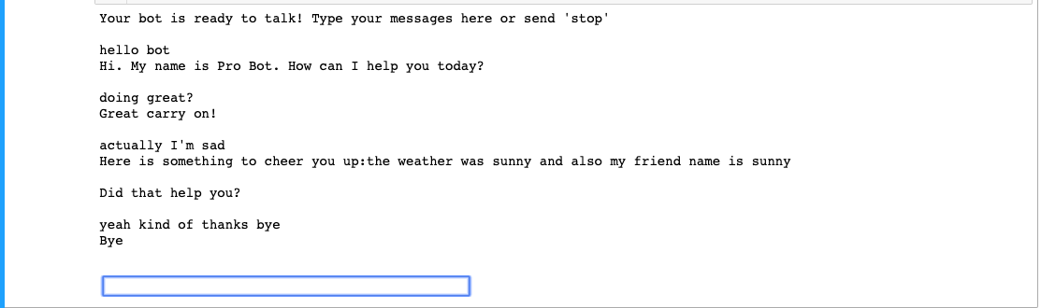
TEST ANALYSIS

Slide 34

THANK YOU

